Slide 1

TDR Strategy : French Robotics Cup
How to score as many points as possible?

Slide 2
Contents
Analysis: How to score points?
Constraints: At what cost?
Possible solutions: Which are the possible solutions?
Optimization: What is our choice?

Slide 3
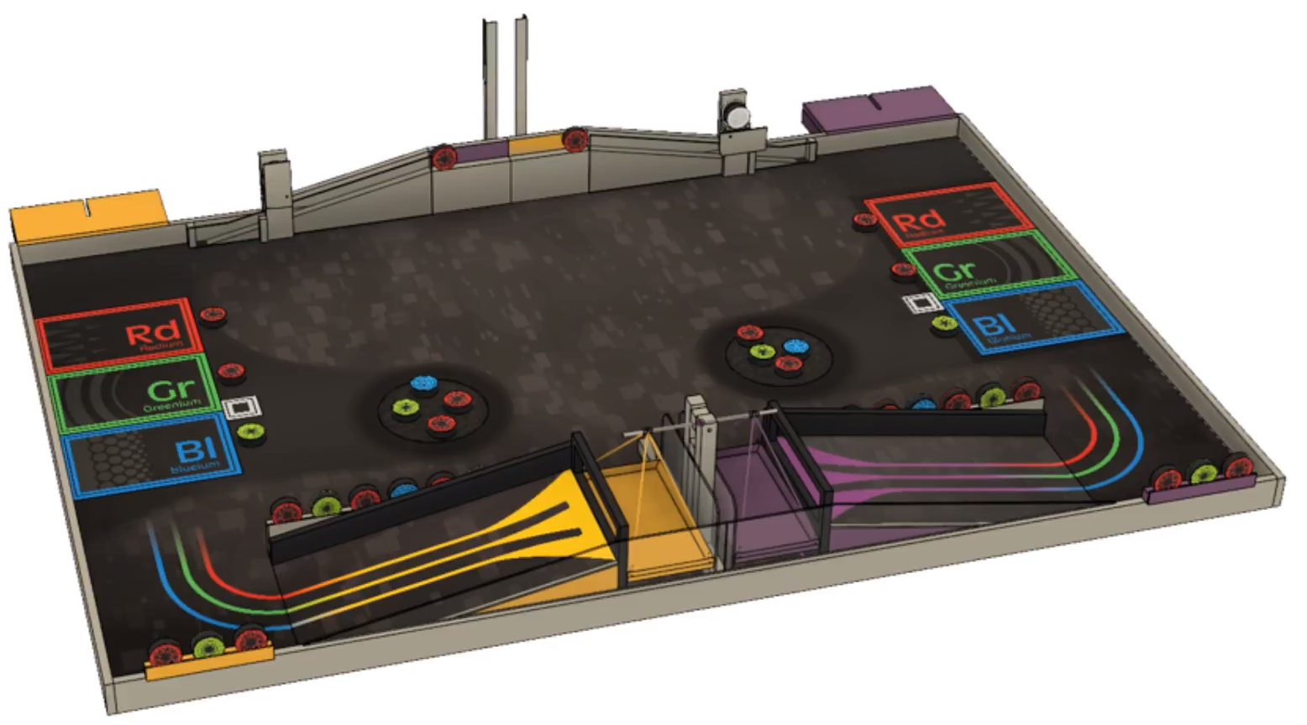
Analysis - How to score points?

Slide 4
Analysis - How to score points?
Action |  | Points
Moving atoms | place in wrong area | 1 each
 | place in good area | 6 each
 | place goldenium | 6
Weight | red | 4 each
 | green | 8 each
 | blue | 12 each
 | gold | 24 each
Bonus (only in final matches) | The more points in the weighing scale | 30

Slide 5
New elements | place atoms in accelerator | 10 each
 | unlock | 10
 | extraction | 20
Experiment | settle experiment | 5
 | activation | 15
 | success | 20
Evaluation | Estimate your score | 0.3*score-difference

Slide 6
2. Constraints - At what cost?
Classification of the atoms
Moving atoms → Friction, precision, grab?
Sorting atoms → recognition + extraction + moving without mixing already sorted atoms
Placing Goldenium → unlock + precision
Weighing the atoms → move + climb
Redium 60g → light and common
Greenium 120g → heavier + ordinary
Blueium 170g → quite heavy + rare
Goldenium 340g → very heavy + unique
Bonus (only in final stage)
Optimizing the atom in the weighing scale → recognition + optimisation

Slide 7
Accelerator
Placing → grabbing + elevating + placing
Unlock → pushing an atom (already existing)
Goldenium extraction → unlock + heavier
Experiment
Settled → little cost (before the match)
Activated → can be easy : mechanically
Achieved → if tested before, no costs
Evaluation
Estimate or compute → predictable strategy or atom analysis (camera)

Slide 8
3. Possible solutions
Experiment (up to 40 pts)
failure does not affect the robot
Evaluation ( > 0 pts)
Focusing on atoms (up to 30 pts with 5 atoms)
finding and processing atoms (differentiating them with the camera)
getting back atoms to their spot
easy not to end with zero pts
harder with the number of atoms increasing

Slide 9
Unlocking goldenium (up to 40 pts)
requires precise placement : our objective
high-ground manipulation and grabbing (for going backward and pull it)
Chaining of actions (small risk of 0 points strategy)
increasing the probability of meeting with the opponent
Does not depend on the atoms placement
Interacting with the balance (up to 40 pts or 55 with gold)
need to use the inclined plane, or to lift atoms
requires a complex system (mechanical arm?) to grab and lift atoms
real gain only if able to put other than red
jackpot for finals
risk of 0 pts

Slide 10
4. Optimization - What is our choice?
Activating the experiment
activation with no move would be good
Going for the goldenium
moving from and toward a known spot
precise position given by the camera
Investing the rest of the time to push atoms :
detecting the color and position of atoms with the camera
optimizing the placement of atoms given the precision of manipulation
Evaluating the score
success control with the camera

Slide 11
Points we intend to score
Action | Points
Experiment | 40
Accelerator + goldenium | 40
Placing atoms | 20
Score evaluation | 0,3*score = 30
Total | 130

Slide 12
Conclusion
Focus on localisation and precision: goldenium liberation
Adapting to the possibilities of the camera (position of robots and atoms)
Original strategy : no competition for atoms against the opponent

